Slide 1
CharCNNRNN

Slide 2
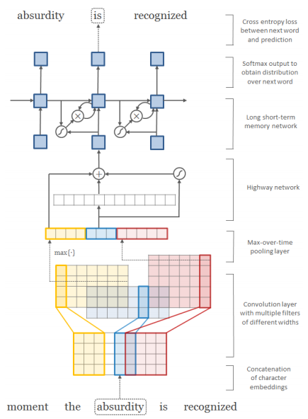
Practice 2
Title : character-aware neural language models
CharCNN
Detect sub-word information (eventful, eventfully)
Does not require morphological tagging as preprocessing step
Data Set
English Penn Treebank (PTB)

Slide 3
Practice 2: CharCNNRNN
Preprocessing
Character to index
Word to index
self.vocab_size = len(self.w2idx) self.char_size = len(self.c2idx) self.train_size = len(self.train_ids) self.val_size = len(self.val_ids) self.test_size = len(self.test_ids) self.idx2w, self.idx2c = {}, {} for word in self.w2idx: self.idx2w[self.w2idx[word]] = word for char in self.c2idx: self.idx2c[self.c2idx[char]] = char def file_to_ids(self, file_name): with open(file_name, "r") as fin: lines = fin.readlines() max_size = 20 length, ids, chars = [], [], []

Slide 4
Practice 2: CharCNNRNN
Preprocessing
for num, line in enumerate(lines): id = np.zeros(self.max_seq_len, dtype=np.int32) char = np.zeros((self.max_seq_len, self.max_word_len), dtype=np.int32) # line += " <e>" words = line.split() for i, word in enumerate(words): if i == self.max_seq_len: break if word not in self.w2idx: self.w2idx[word] = len(self.w2idx) id[i] = self.w2idx[word] for j, w in enumerate(word): if j == self.max_word_len: break if w not in self.c2idx: self.c2idx[w] = len(self.c2idx) char[i][j] = self.c2idx[w]

Slide 5
Practice 2: CharCNNRNN
Model
Add Embedding Layer
Setup Layers
Make Loss and Optimization
Train Model

Slide 6
Practice 2: CharCNNRNN
Embedding Layer (Model)
Code
self.embW_char = self.get_var(name="emb_char", shape=[self.char_size, self.emb_dim]) self.embW_word = self.get_var(name="emb_word", shape=[self.vocab_size, self.emb_dim]) self.batch_size = tf.shape(self.x_char)[0] self.x_char_emb = tf.nn.embedding_lookup(self.embW_char, self.x_char[:, :-1]) self.x_word_emb = tf.nn.embedding_lookup(self.embW_word, self.x_word[:, :-1])

Slide 7
Practice 2: CharCNNRNN
Setup Layers (Model)
Convolutional Layer with Multiple filters of different widths

Slide 8
Practice 2: CharCNNRNN
Setup Layers (Model)
Code
def build_model(self): # Dimension change for conv net x_char_4d = tf.reshape(self.x_char_emb, [-1, self.max_word_len, self.emb_dim, 1]) # Create a convolution + maxpool layer for each filter size pooled_outputs = [] for filter_size, filter_num in zip(self.filter_sizes, self.filter_nums): # Seperated name scope for variables (W, b) for each filters with tf.name_scope("conv-maxpool-%s" % filter_size): # Convolution Layer filter_shape = [filter_size, self.emb_dim, 1, filter_num] W = tf.Variable(tf.truncated_normal(filter_shape, stddev=0.1), name="W") b = tf.Variable(tf.constant(0.1, shape=[filter_num]), name="b") # Apply nonlinearity conv = tf.nn.conv2d(x_char_4d, W, strides=[1, 1, 1, 1], padding="VALID", name="conv") h = self.leaky_relu(conv + b) # Maxpooling over the outputs pooled = tf.nn.max_pool(h, ksize=[1, self.max_word_len - filter_size + 1, 1, 1], strides=[1, 1, 1, 1], padding='VALID', name="pool") pooled_outputs.append(pooled)

Slide 9
Practice 2: CharCNNRNN
Setup Layers (Model)
Combine All the pooled layers

Slide 10
Practice 2: CharCNNRNN
Setup Layers (Model)
Code
# Combine all the pooled features num_filters_total = sum(self.filter_nums) h_pool = tf.concat(pooled_outputs, 3) self.h_pool_3d = tf.reshape(h_pool, [-1, self.max_seq_len-1, num_filters_total])

Slide 11
Practice 2: CharCNNRNN
Setup Layers (Model)
Recurrent Neural Network for Word and Char

Slide 12
Practice 2: CharCNNRNN
Setup Layers (Model)
Code
# vector of word & character self.word_char = tf.concat([self.x_word_emb, self.h_pool_3d], 2) print(self.word_char.shape) # RNN for word+char lstm_cell = rnn.BasicLSTMCell(self.rnn_hidden_dim) output, states = tf.nn.dynamic_rnn(cell=lstm_cell, inputs=self.word_char, sequence_length=self.x_len, dtype=tf.float32) output_2d = tf.reshape(output, [-1, self.rnn_hidden_dim]) out_W = self.get_var(name="out_W", shape=[self.rnn_hidden_dim, self.vocab_size]) out_b = self.get_var(name="out_b", shape=[self.vocab_size]) self.word_prob = tf.nn.softmax(tf.matmul(output_2d, out_W) + out_b) self.output = tf.argmax(tf.reshape(self.word_prob, [-1, self.max_seq_len-1, self.vocab_size]), 2)

Slide 13
Practice 2: CharCNNRNN
Build Loss
Code
Build Optimizer
Code
def build_loss(self): self.cross_entropy = -tf.reduce_sum( tf.one_hot(tf.to_int32(tf.reshape(self.target, [-1])), self.vocab_size, 1.0, 0.0) * tf.log(tf.clip_by_value(tf.reshape(self.word_prob, [-1, self.vocab_size]), 1e-20, 1.0)), 1) self.loss = tf.reduce_sum(self.cross_entropy * self.mask_1d) / tf.reduce_sum(self.mask_1d)
def build_opt(self): # define optimizer optimizer = tf.train.AdamOptimizer(learning_rate=self.learning_rate) grad, var = zip(*optimizer.compute_gradients(self.loss))

Slide 14
Practice 2: CharCNNRNN
Train Model and Result
Code
for it in range(0, 10000): train_ids, train_chars, length = data.get_train(BATCH_SIZE) loss, _ = sess.run([model.loss, model.update], feed_dict={model.x_word: train_ids, model.x_char: train_chars, model.x_len: length}) avg_loss += loss it_cnt += 1 if it % it_log == 0: print(" it: {:4d} | loss: {:.3f} - {:.2f}s".format(it, avg_loss / it_cnt, time.time() - start_time)) avg_loss, it_cnt = 0, 0 if it % it_test == 0 and it > 0: test_model() if it % it_save == 0 and it > 0: model.save(sess) if it % it_sample == 0 and it > 0: sample_test("we 're talking about years ago before ")

Slide 15
Practice 2: CharCNNRNN
Result
it: 810 | loss: 0.542 - 17.68s
it: 820 | loss: 0.520 - 17.88s
it: 830 | loss: 0.499 - 18.11s
it: 840 | loss: 0.480 - 18.31s
it: 850 | loss: 0.462 - 18.50s
it: 860 | loss: 0.445 - 18.70s
it: 870 | loss: 0.429 - 18.89s
it: 880 | loss: 0.414 - 19.08s
it: 890 | loss: 0.399 - 19.27s
it: 900 | loss: 0.386 - 19.47s
test loss: 9.989
['we', "'re", 'talking', 'about', 'years', 'ago'] --> before (answer: before)

